Slide 1
Online Payment Request
August 2023 – K.Murray
https://form.jotform.com/azquiltersguild/payment-request

Slide 2
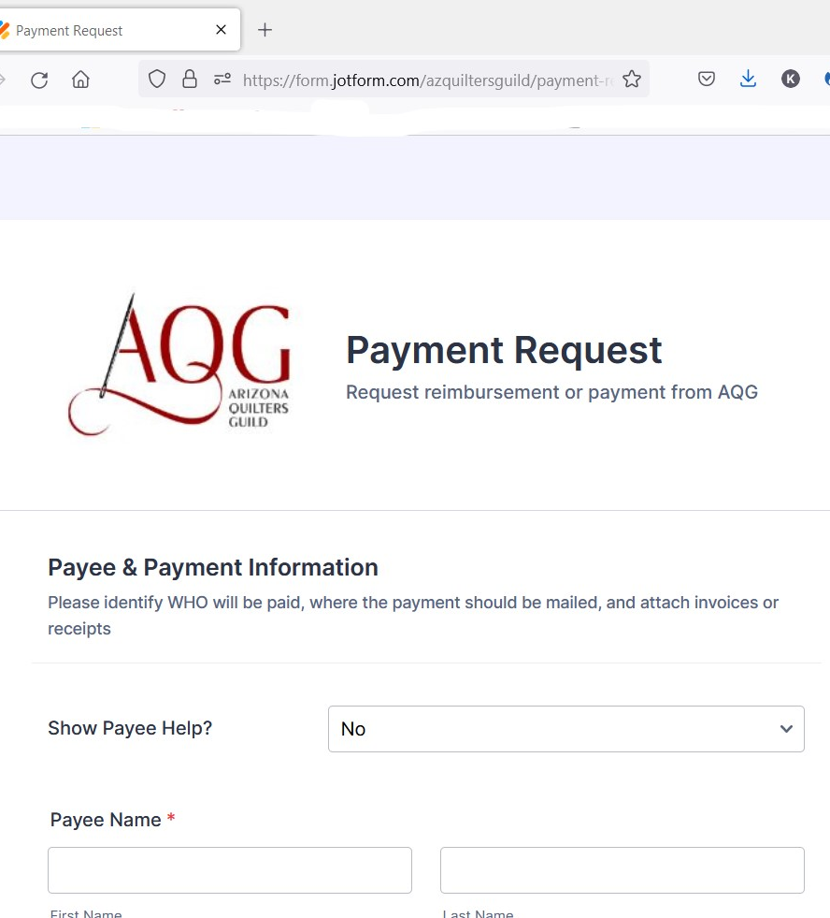
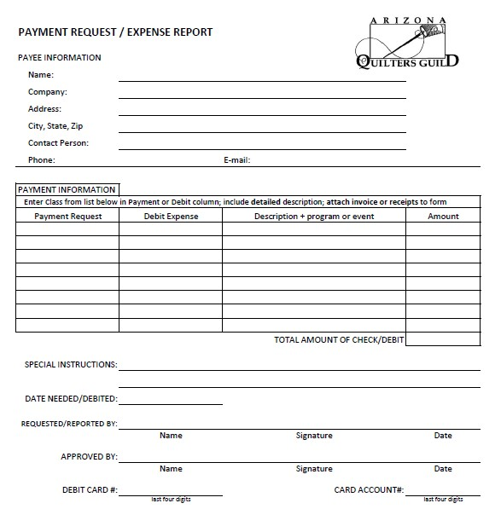
The Payment Request form is moving online …
… what you need to know

Slide 3
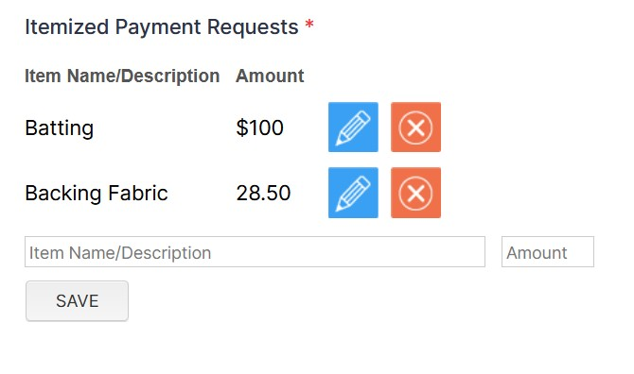
Page 1 includes the same basic questions as the paper form:
Payee Contact Info: who needs to be paid?
List all the requested payments
Calculate the total requested amount

Slide 4
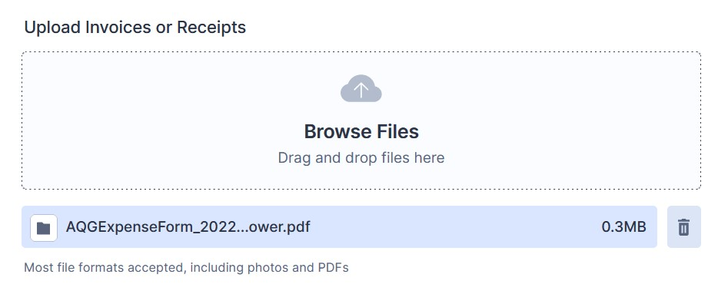
Don’t forget to upload the invoices or receipts !!
Missing paperwork is the most common reason for a payment request to be denied.

Slide 5
Identify who should be involved in Approving this payment
Submitter = This is the person filling out the answers on this form. The Confirmation email will be sent to the Submission email address.
Requestor = This is an AQG Board Member or Committee Chair who is authorized to request payments from a specific budget category.
Need Help?? Flip the switch …

Slide 6
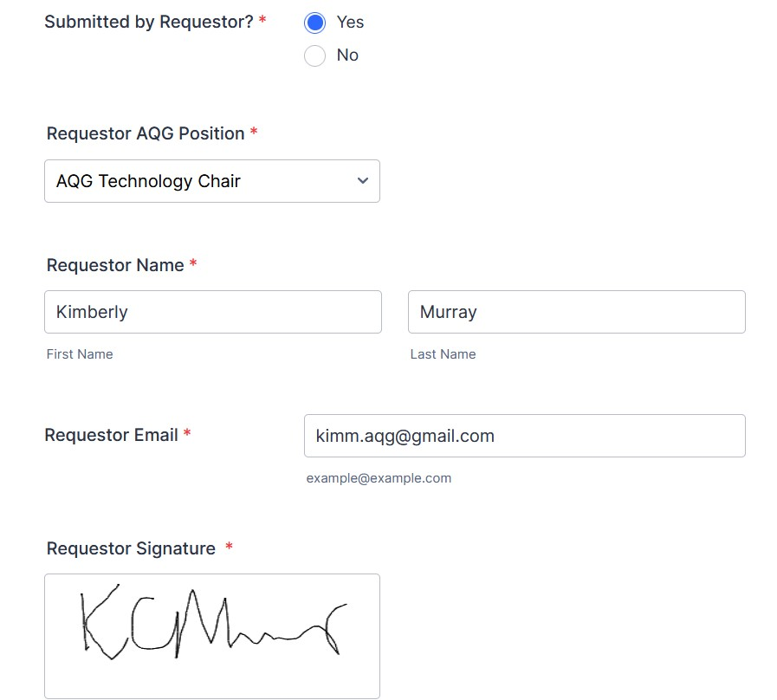
If the Submitter is an AQG Board Member or Committee Chair …
Identify yourself as the Requestor and sign the form

Slide 7
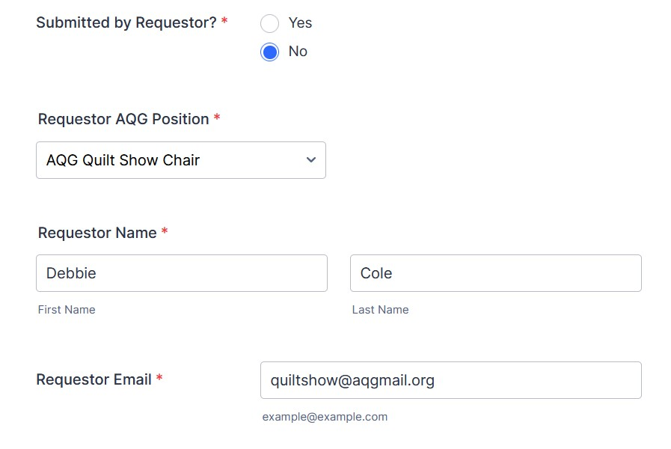
For everyone else …
Please identify the Requestor. The form will be automatically sent to them for signature.

Slide 8
How to respond to a “Requestor Signature Required” email
1. Click green/red button in email to open interface:
2. Approval or Deny & Sign (see screenshot next slide)
… Be sure to write comments for denied requests !!

Slide 9
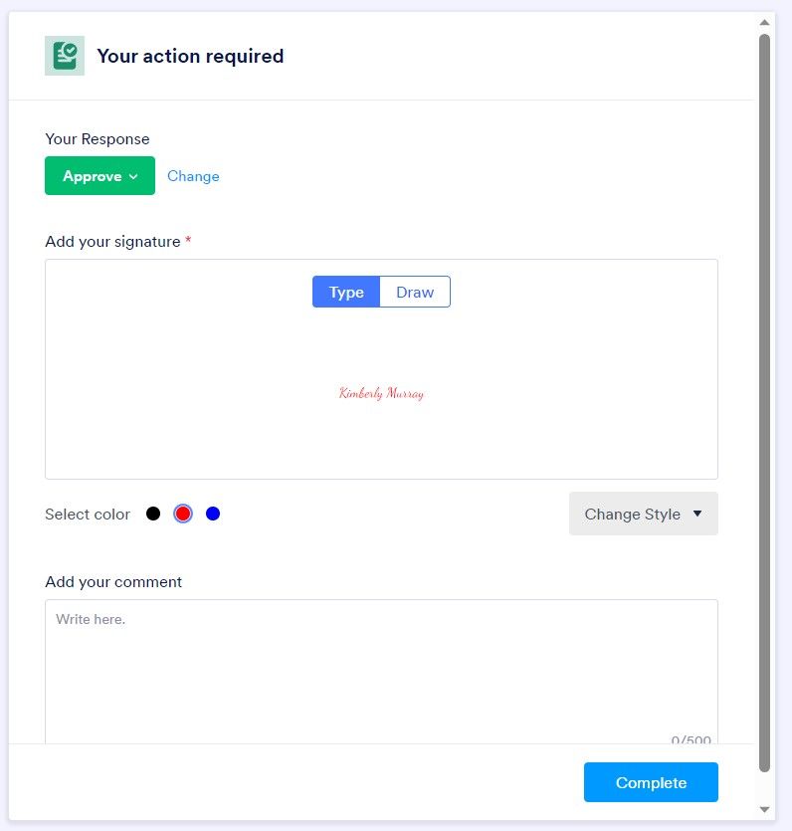
Requestor Signature Interface
1. Approve / Deny
2. Type / Draw Signature
3. Comment (esp. for Denials)
4. DONE

Slide 10
What happens when you SUBMIT ?
Almost immediately, the Submitter will receive a confirmation email for their records.
The completed form will be automatically sent to the AQG authorities for signature approval.
The signed form will be sent to the AQG Treasurer for payment processing, and a status email will be sent to the Submitter.
Questions ???
Contact treasurer@aqgmail.org

